Slide 1
Geolocation
Parker Zhou
parkerzho2010@gmail.com

Slide 2
What’s that?
API provides device location information(latitude longitude)
Source
Global Positioning System(GPS)
Network(IP Wi-Fi..)
Notes:
Equator Greenwich

Slide 3
API
getCurrentPosition
watchPosition
clearWatch
coords

Slide 4
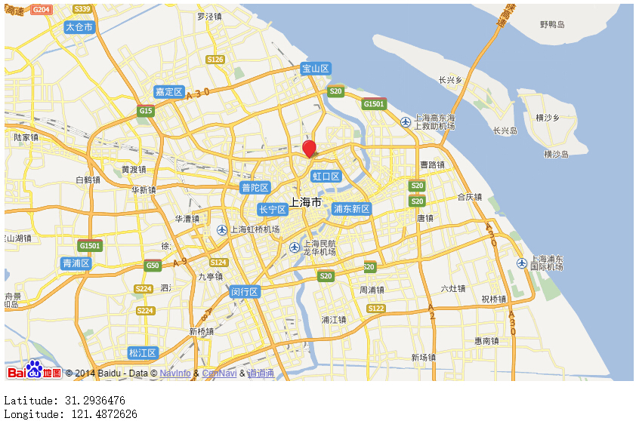
Sample
Notes:
http://developer.baidu.com/map/jsdemo.htm#i8_4
…
var map = new BMap.Map("allmap");
map.centerAndZoom(new BMap.Point(116.331398,39.897445),11);
map.enableScrollWheelZoom(true);
…
map.clearOverlays();
var new_point = new BMap.Point(e.coords.longitude , e.coords.latitude);
var marker = new BMap.Marker(new_point); // 创建标注
map.addOverlay(marker); // 将标注添加到地图中
map.panTo(new_point);

